Slide 1
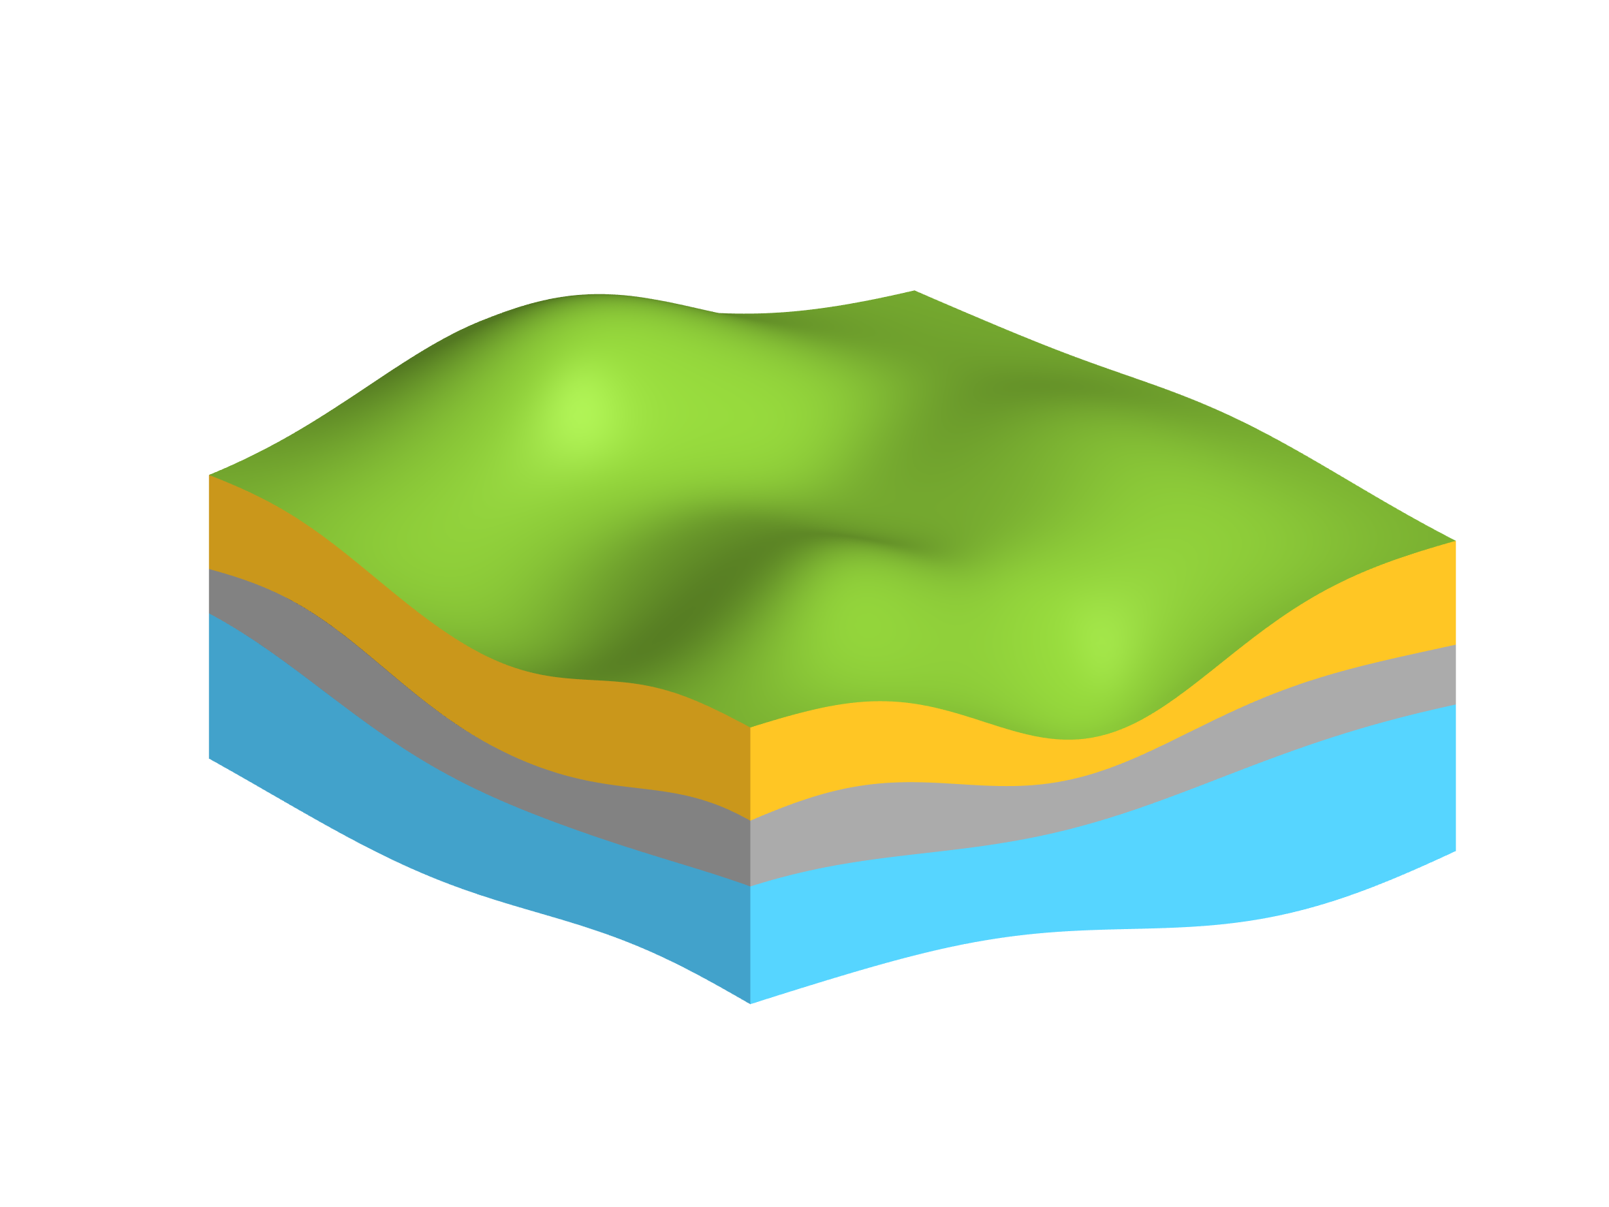
Precipitation
Infiltration YBT dam
Infiltration/ Drainage
Massa River
Pumping Irrigation
Irrigation
returns
Pumping Drinking
Groundwater outflow
Groundwater inflow

